Slide 1
Linking Geography with Math and Science
Lessons 1-2: Florida Geography,
Climate Change and Sea Level Rise

Slide 2
What is Geography?
BIOGRAPHY:
Bio = Life
Graphy = Write about
GEOGRAPHY:
Geo = Earth
Graphy = Write about
Write about the Earth or any part of the Earth (Places)

Slide 3
Geography: Two Parts
Physical Geography: Things the Earth creates and changes itself (no help from humans)
Human Geography: Things done to the Earth by humans
We see both of these geographies on the surface of the Earth and that’s called the “landscape”

Slide 4
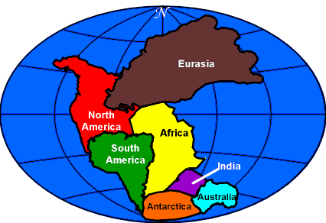
Write a Geography of Florida
Physical Geography: Shape, Rocks, Soil

Slide 5
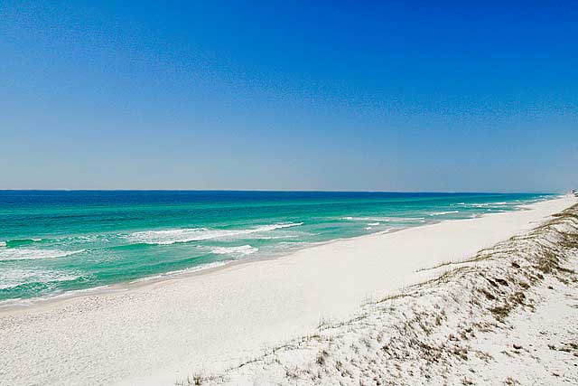
Write a Geography of Florida
Physical Geography: Terrain and Elevation

Slide 6
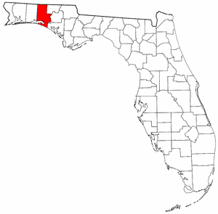
Write a Geography of Florida

Slide 7
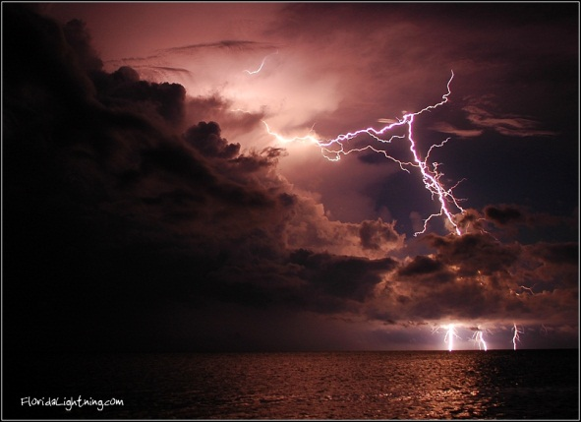
Write a Geography of Florida
Physical Geography: Climate & Weather

Slide 8
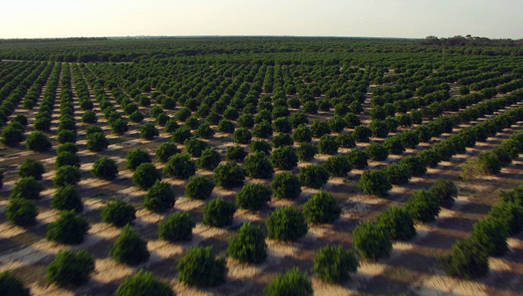
Write a Geography of Florida
Human Geography: Agriculture

Slide 9
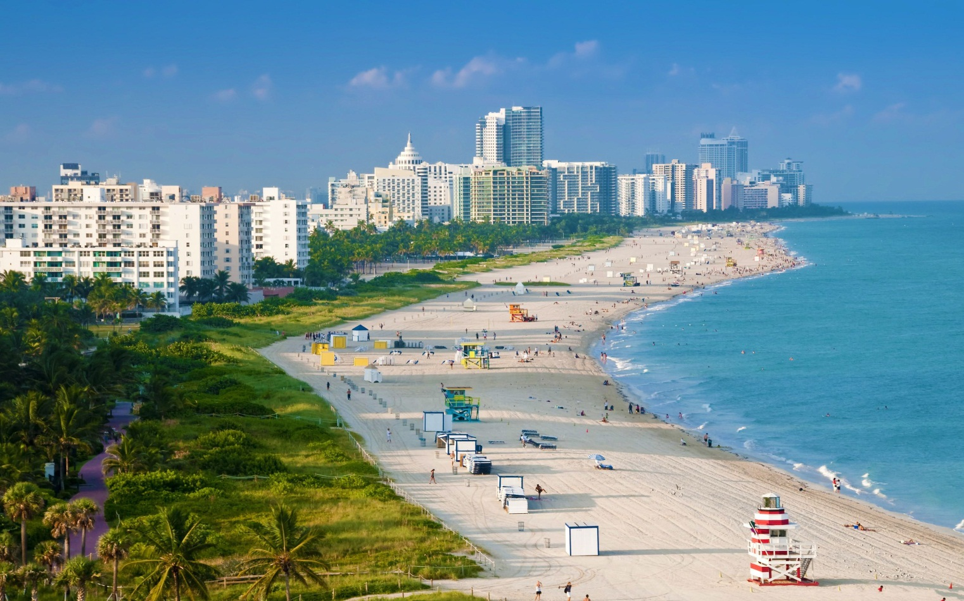
Write a Geography of Florida
Human Geography: Housing

Slide 10
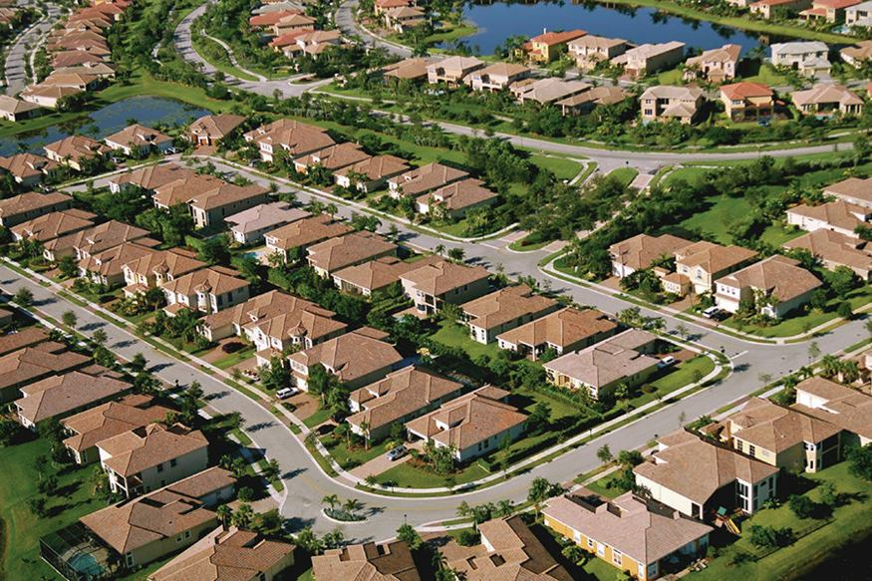
Write a Geography of Florida
Human Geography: Housing

Slide 11
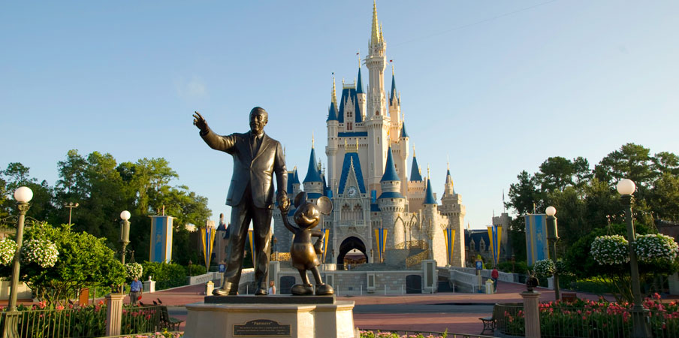
Write a Geography of Florida
Human Geography: Tourism

Slide 12
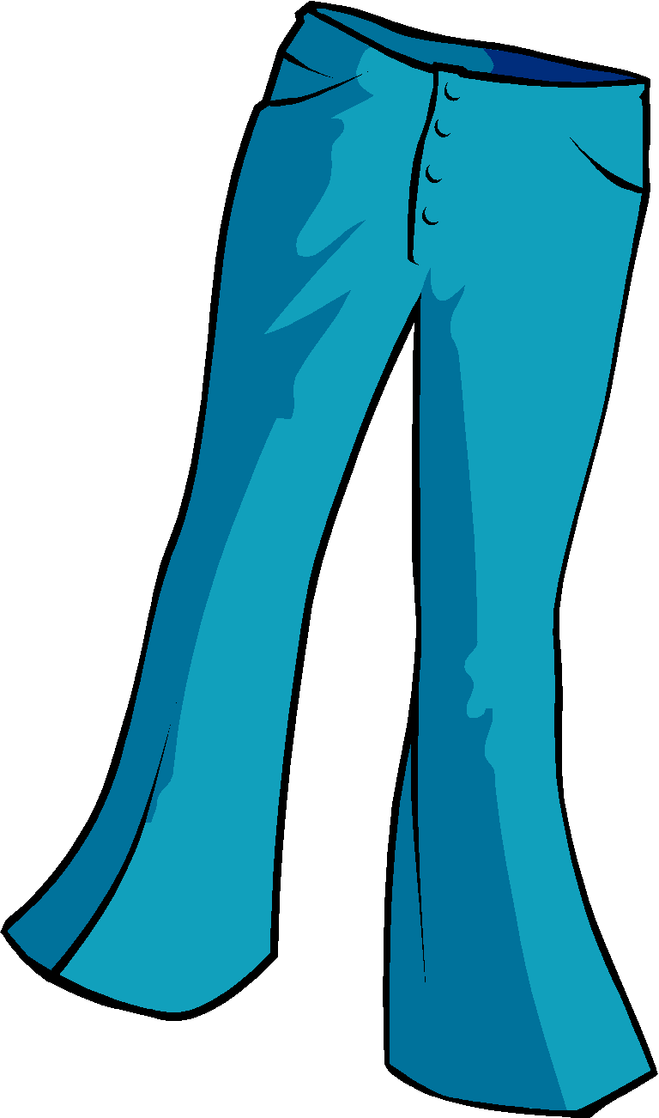
Climate vs. Weather
Climate helps you decide what clothes to buy, and weather helps you decide what clothes to wear each day.
Notes:
Imagine that last summer was much hotter than usual where you live. Is this a sign of climate change? Yes or no?
No. The weather naturally varies from year to year, and some years are hotter than others.
Imagine that almost every summer for the past decade has been hotter than usual. Is this a sign of climate change? Yes or no?
Yes. Climate change occurs over many years, so a pattern of many hotter summers could be a sign of climate change. This is especially true if the same pattern is happening in many places around the world.

Slide 13
Ancient Florida
36-40 million years ago

Slide 14
Ancient Florida
20-28 million years ago

Slide 15
Ancient Florida
15-16.5 million years ago

Slide 16
Ancient Florida
4-8 million years ago

Slide 17
Ancient Florida
4-2.5 million years ago

Slide 18
Ancient Florida
1.5 million years ago

Slide 19
Ancient Florida
150-100 thousand years ago

Slide 20
Present Day Florida

Slide 21
The Greenhouse Effect
Animation
The Earth's climate has changed before, but this time is different.
People are causing bigger and faster changes to the Earth’s climate
Notes:
The Earth is getting warmer because people are adding heat-trapping gases to the atmosphere, mainly by burning fossil fuels. These gases are called greenhouse gases. Warmer temperatures are causing other changes around the world, such as melting glaciers and stronger storms. These changes are happening because the Earth's air, water, and land are all linked to the climate.

Slide 22
What are the impacts to current climate change?
??
Notes:
If the Earth keeps getting warmer, up to one–fourth of all the world's plants and animals could become extinct within 100 years.

Slide 23
Sea Level Rise
As water gets warmer it expands (molecules spread out) and takes up more room
Add melting ice sheets and glaciers = sea level rise
Notes:
As water gets warmer, it takes up more space. Each drop of water only expands by a little bit, but when you multiply this expansion over the entire depth of the ocean, it all adds up and causes sea level to rise. Sea level is also rising because melting glaciers and ice sheets are adding more water to the oceans.

Slide 24
Icebergs float in the ocean

Slide 25
As icebergs melt…

Slide 26
Ice sheets are on land
Notes:
Although the earth has many locations with permanent ice and glaciers, there are only two ice masses that are large enough to be classified as ice sheets: the greenland ice sheet and the antarctic ice sheet. These ice sheets are composed of snow that has fallen, become buried due to additional snowfall over time, and eventually been compressed into very thick ice. The ice sheets are over 1 kilometre thick on average and are the largest reservoir of fresh water on the earth.

Slide 27
As ice sheets melt…
Notes:
It is over 4.5 km (~ 2.8 miles) deep in its deepest spot. Most (around 90%) of the fresh water on the surface of the earth, and 98% of the earth’s ice, exists as ice in Antarctica; if it all melted, it would raise sea level by approximately 60 meters. The Greenland ice sheet started forming around one million years ago, and in the center it is over three kilometers (~ two miles) deep. If the Greenland ice sheet melted, it would raise sea level by approximately 6 meters.

Slide 28
What will happen?
The average sea level around the world by the end of this century (the year 2099) could be anywhere from 7 to 23 inches higher than it was in 1990

Slide 29
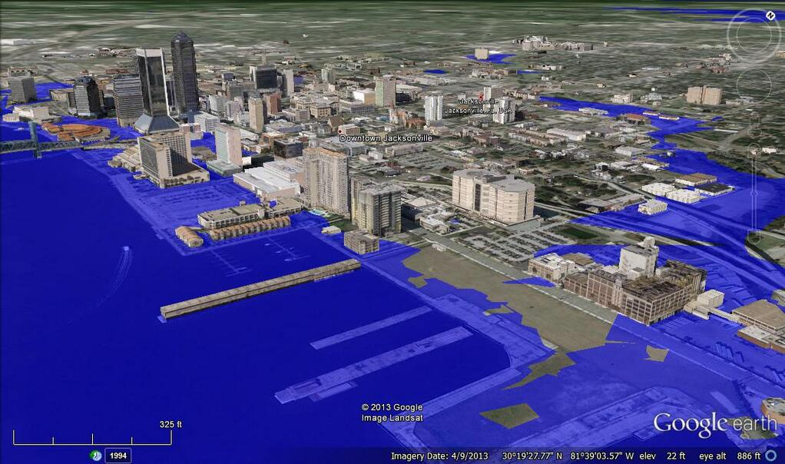
Notes:
Jacksonville, 1 m sea level rise

Slide 30
References
The Geology of the Everglades and Adjacent areas by Edward J. Petuch and Charles Roberts
www.epa.gov/climatechange/kids
https://twitter.com/SFriedScientist/status/390890024499040257/photo/1

