Slide 1
Linking Geography with Math and Science
Lessons 3-4: Finding our Place on the Earth, The Cartesian Plane, and Latitude and Longitude

Slide 2
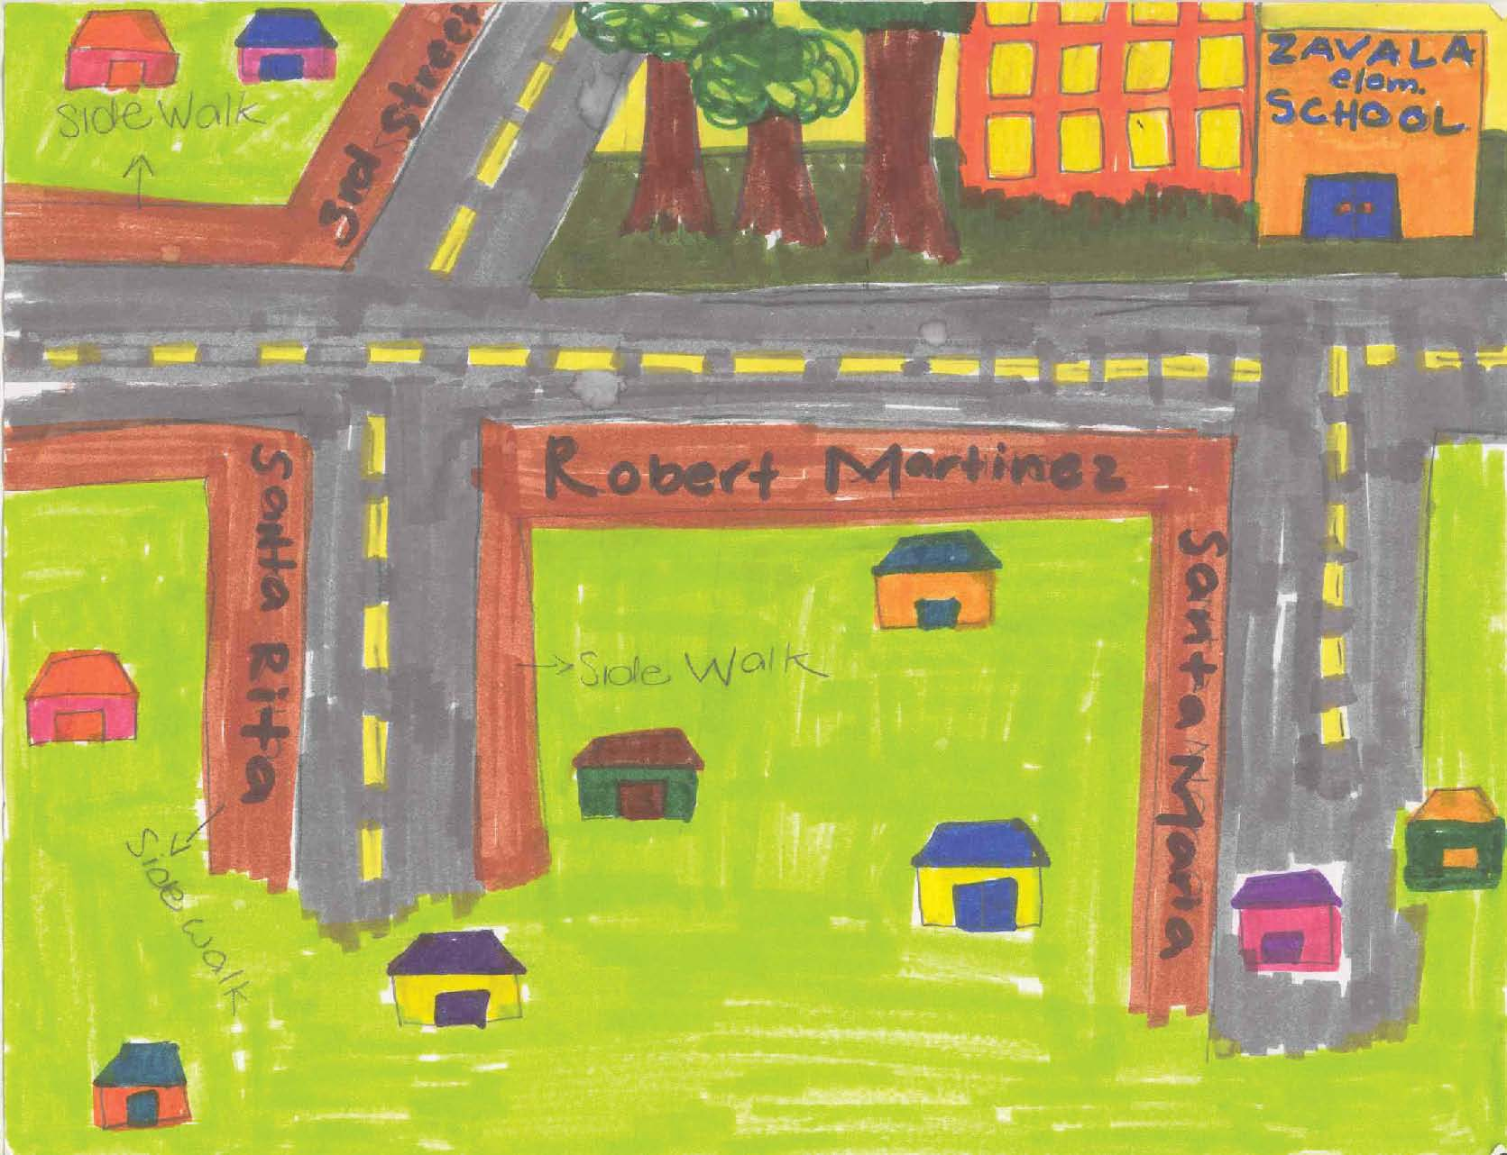
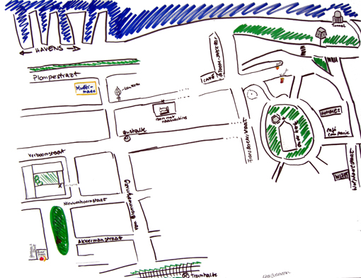
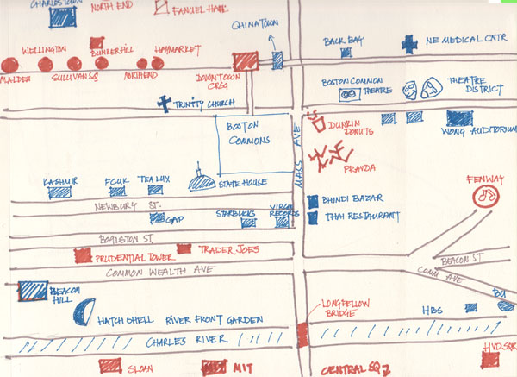
Mental Map
http://ocw.mit.edu/
http://mentalcharlois.wordpress.com/
http://moodle.oakland.k12.mi.us/
Notes:
impressions and images of our physical surroundings—even of places we’ve never been
Mental maps all start from a central place (the area from where you start drawing your mental map). This may be your home, a park in your neighborhood, a church, your state, or your country.

Slide 3
Mental Map of SJEDS Campus
What are some of the central – main locations?
Where are the important places?
What surrounds SJEDS?

Slide 4
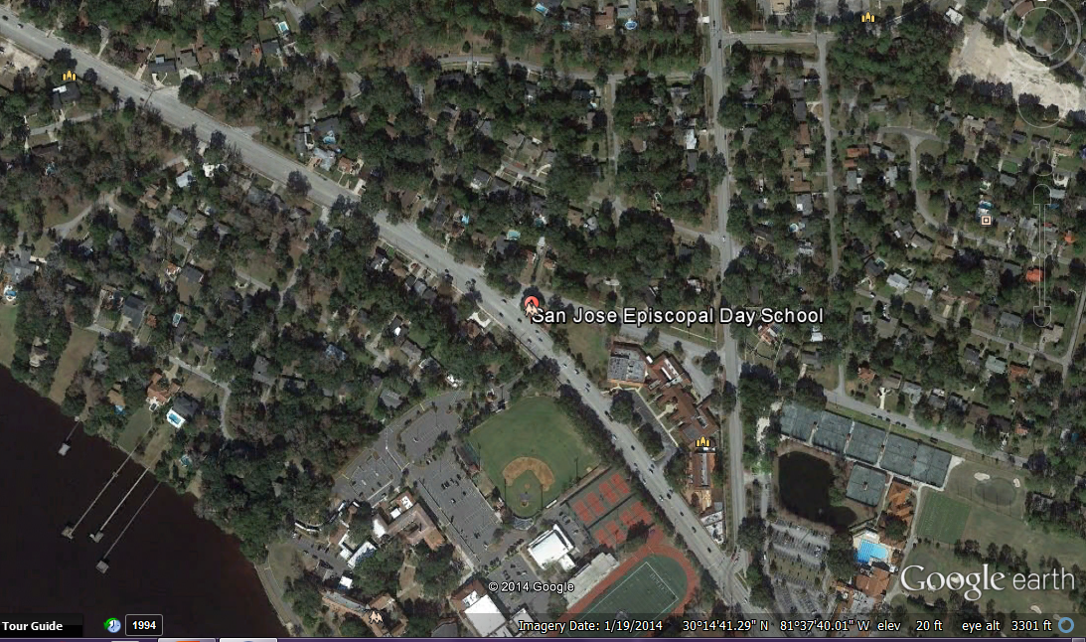

Slide 6
Where in the world are we?
Cartesian Plane
Robot coordinates

Slide 7
World Latitude - Longitude

Slide 8
Florida Latitude - Longitude

Slide 9
