Slide 1
Linking Geography with Math and Science
Lessons 5-6: Latitude and Longitude, The Cartesian Plane, and Calculating Area

Slide 2
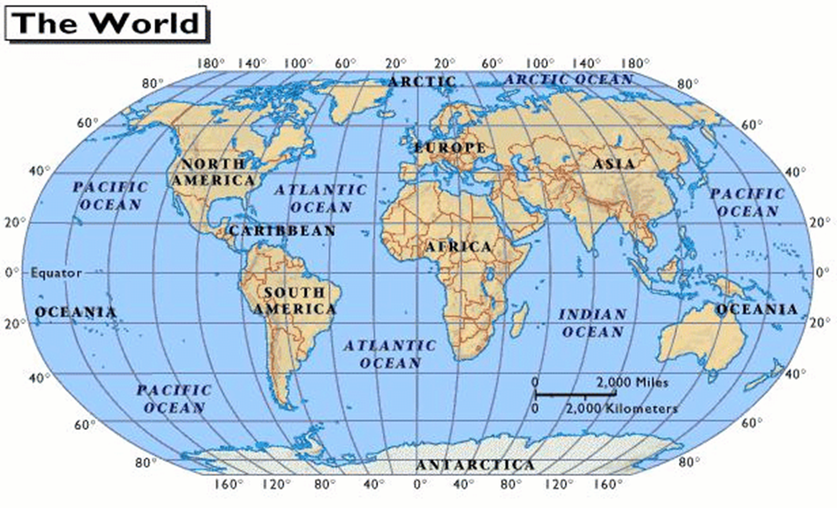

Slide 3
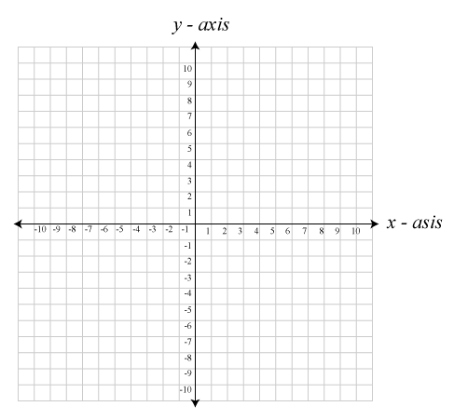

Slide 4
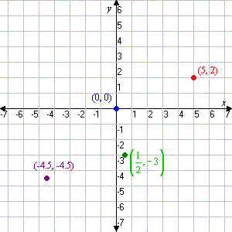
Ordered Pairs = (x,y)

Slide 5
Take a closer look…
Ordered pairs
Cartesian plane
Can you move your robot?
http://shodor.org/interactivate/activities/SimpleMazeGame/
Latitude - Longitude

Slide 6
What happens when…
Perimeter
Area

Slide 7
Jax Beach
Notes:
(30.335591665242696, -81.39558613300323)
(30.33567023777137, -81.39468491077423)
(30.33318862495503, -81.3943737745285)
(30.333162433455335, -81.3953286409378)

