Slide 1
Linking Geography with Math and Science
Lessons 7-8: Impacts of Sea Level Rise on Human Geography, and Calculating Financial Impacts

Slide 2
Patti Sunshine’s Beach Umbrella Rental
Each umbrella requires 9 square feet.
How long is each side of the square?
Each umbrella rents for $10 a day
How many spots (squares) of 9 square feet are currently available on the beach?
How much money does she make each day?

Slide 3
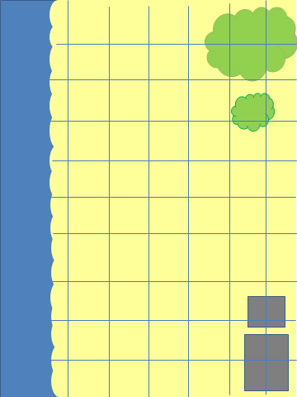

Slide 5
After Sea Level Rise
How many fewer spots (squares) are there on the beach?
How much less money does Patti now make each day?
What percentage of her daily income has Patti ?
How much more would she need to charge per umbrella to regain her lost income?

