Slide 1
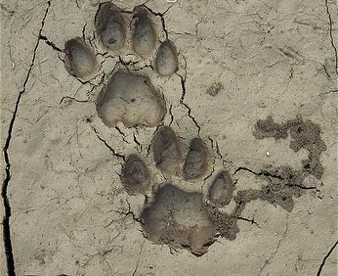
Linking Geography with Math and Science
Lesson 5: Climate Change, Sea Level Rise and Physical Geography: Impacts on Biodiversity

Slide 2
Impacts of Habitat Loss
Population Connection Exercise: Panther Hunt https://www.populationeducation.org/sites/default/files/panther_hunt.pdf

Slide 3
Sea Level Rise and the Florida Panther
The Florida panther, Florida’s state animal, is one of the most endangered mammals on earth
The panther’s habitat in southern Florida is all at very low elevation above sea level.
The three feet of sea level rise projected to occur by the end of this century will inundate 30% of existing panther habitat.

Slide 4
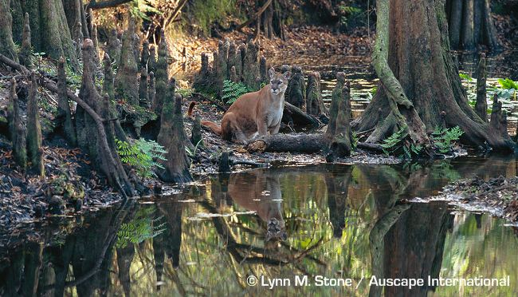
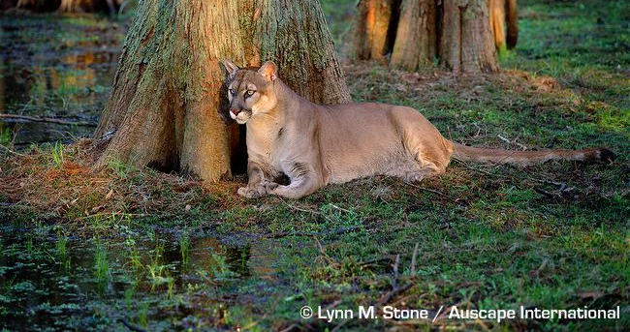

Slide 5
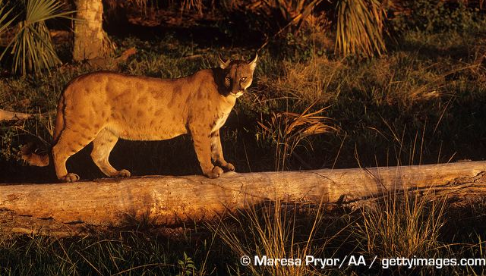
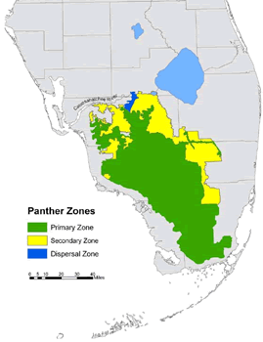
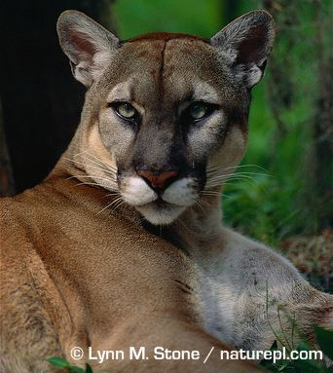

Slide 6
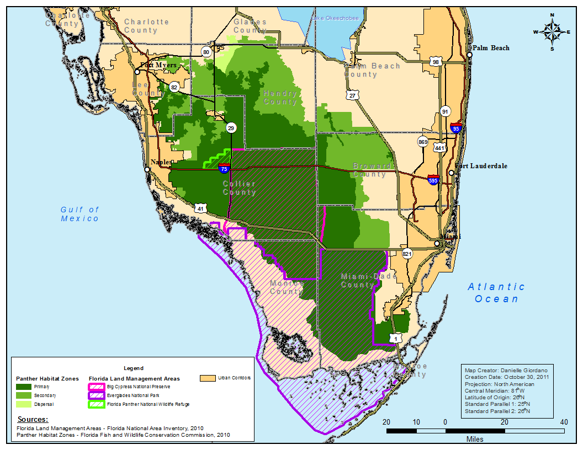

Slide 7
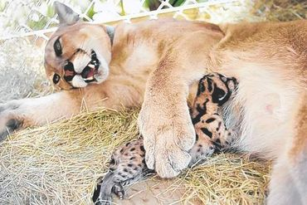
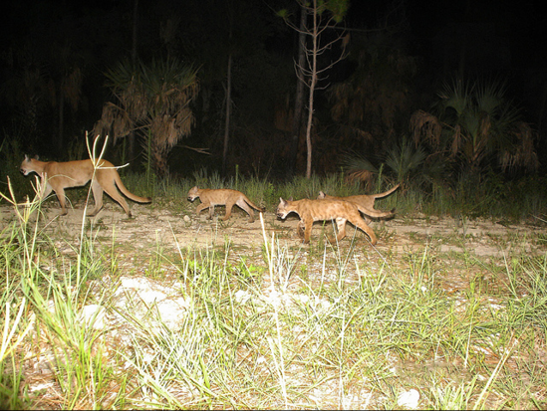
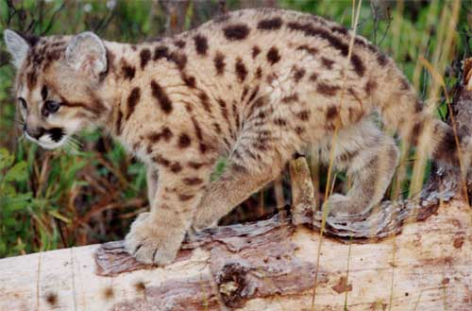

Slide 8
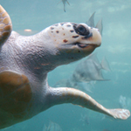
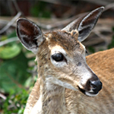
Other Species Impacted by SLR
Loggerhead Turtle
Key Deer

Slide 9
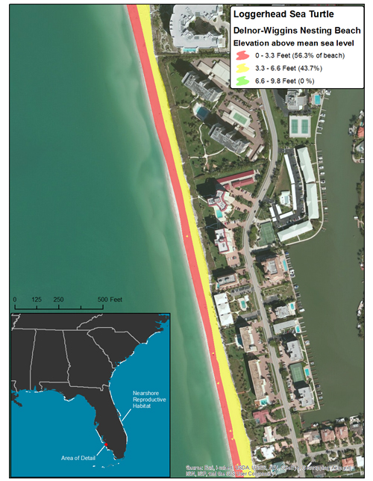

Slide 10
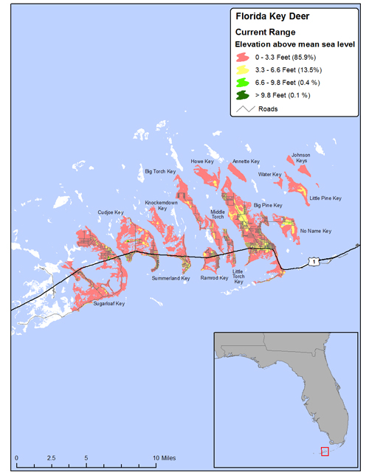

Slide 11
